Slide 1
Programming and automated signal analysis
Ilse Jonkers
Wouter Aerts, Maarten Afschrift,
Jozefien Burg, Lianne Zevenbergen

Slide 2
Practical session III: Relational and logical operators

Slide 3
Priority
Precedence | Operation
1 (Highest) | Parenthesis ()
2 | Transpose (.'), power (.^), complex conjugate transpose ('), matrix power (^)
3 | Unary plus (+), unary minus (-), logical negation (~)
4 | Multiplication (.*), right division (./), left division (.\), matrix multiplication (*), matrix right division (/), matrix left division (\)
5 | Addition (+), subtraction (-)
6 | Colon operator (:)
7 | Less than (<), less than or equal to (<=), greater than (>), greater than or equal to (>=), equal to (==), not equal to (~=)
8 | Element-wise AND (&)
9 | Element-wise OR (|)
10 | Short-circuit AND (&&)
11 (Lowest) | Short-circuit OR (||)

Slide 4
Exercise 1: relational and logical operators

Slide 5
Boolean
Logical 1 – true
Logical 0 – false

Slide 6
Relational operators
Operator |  | Operation
== | eq | Equal to
~= | ne | Not equal to
> | gt | Greater than
>= | ge | Greater than or equal to
< | lt | Less than
<= | le | Less than or equal to
The relation is always read rom left to right

Slide 7
Relational operators
Assignment statement ‘=’
A = [10, 12, 8]
B = [6, 12, 9]
Logical relation ‘==’
A == B
isequal
isequal(A,B)

Slide 8
Exercise 1: relational and logical operators
Part 1: relational operators
a = 1; b = 2; c = 3; d = 1;
p1 = a == d; p12 = eq(a,d);
p2 = c > b; p22 = gt(c,b);
p3 = c >= b; p32 = ge(c,b);
p4 = a <= c; p42 = le(a,c);
p5 = a ~= d; p52 = ne(a,d);
p6 = a < d; p62 = lt(a,d);

Slide 9
Logical operators
Operator |  | Operation
~ | not | Logical NOT | If true, then false; if false, then true
& | and | Logical AND | True only if both values are true
| | or | Logical OR | True if either value is true
xor |  | Logical exclusive-OR | True only if both values are different
&& |  | Logical AND with short-circuit evaluation | True only if both values are true
|| |  | Logical OR with short-circuit evaluation | True if either value is true
Logical operators are always evaluated from left to right
Logical operators have a lower priority than relational operators

Slide 10
Short circuit vs. non-short circuit operators
The short circuit operators (&&, ||) will stop the evaluation of an expression as soon as the results of the entire expression is known.
Count = 0; Total = 400;
(Count ~= 0) && (Total/Count > 80)
(Count ~= 0) & (Total/Count > 80)

Slide 11
Short circuit vs. non-short circuit operators
Always use the short circuit operators (&&, ||) when comparing single logical values (scalars)
Always use the non-short circuit operators (&, |) when comparing arrays of logical values
Count = 0; Total = 400;
(Count ~= 0) && (Total/Count > 80)
(rand(1,3) > rand(1,3)) & ([3 5 9] > [5 2 6])

Slide 12
Exercise 1: relational and logical operators
Part 2: Logical operators
A = [ 5, -3, 0, 0]; B = [2, 4, 0, 5];
a = 1; b = 2; c = 3; d = 1;
z1 = A | B; z21 = or(A,B);
z2 = A & B; z22 = and(A,B);
z3 = ~A; z32 = not(A);
z4 = ~(A > 4);
z5 = xor(A,B);
z6 = (c > b) && (a == d);
z7 = (c < b) && (a <= d);
z8 = (a < d) || (b > a);
z9 = any(A < c & B > d);

Slide 13
Exercise 1: relational and logical operators
Part 3: Logical indexing
x = [3 16 9 12 -1 0 -12 9 6 1];
y = [3 5 6 1 8 2 9 4 0 7];
a1 = x(x>6);
a2 = y(x<=4);
a3 = x(y<0);
a4 = (x>3)&(x<8);
a5 = x((x<2)|(x>=8));
a6 = y((x<2)|(x>=8));
Set the positive values of x to zero in a new array x1;
Set values of x that are multiples of 3 to 3 (use rem) in a new array x2;
Extract the values of x that are >10 in the array x3.

Slide 14
Exercise 1: relational and logical operators
Part 4: Combining relational and logical operators
C = randperm(10,10); D = 1:10;
subtract from D taking 1 for C <= 7 and 0 otherwise
ones at positions where 2 <= C < 4
ones at positions where C == D or D == 3
1 when ANY of the C elements are larger than 5
1 when ALL D-elements are larger than 2
locate all nonzero elements of array C

Slide 15
Exercise 1: relational and logical operators
Part 4: Leap year
A leap year is a year containing one additional day in order to keep the calendar year synchronized with the astronomical or seasonal year. To determine whether a year is a leap year or not you must check if the year is divisible by 400 or if the year is divisible by 4 and not by 100.
Define a statement ‘leapyear’ which checks if a year is leap year using logical operators and the rem function.

Slide 16
Exercise 2: Rugby Players

Slide 17
Exercise 2: Rugby Players
Position | Height (cm) | Body mass (kg) | 10m (s) | 20m (s) | 40m (s) | Agility (s) | Vertical jump (cm) | VO2 max
Prop | 184 | 101 | 2.14 | 3.62 | 6.18 | 6.37 | 44 | 42.2
Hooker | 172 | 70 | 2.04 | 3.38 | 5.89 | 5.86 | 47.9 | 46.9
SecondRow | 177 | 84 | 2.07 | 3.47 | 5.89 | 6.1 | 49 | 45.1
Lock | 177 | 75 | 2.07 | 3.49 | 5.93 | 5.64 | 45.2 | 44.6
Halfback | 171 | 69 | 1.95 | 3.52 | 5.62 | 6.01 | 50.4 | 50.5
FiveEighth | 176 | 72 | 1.93 | 3.27 | 5.71 | 5.71 | 48.5 | 48.3
Centre | 177 | 80 | 2.02 | 3.34 | 5.71 | 5.89 | 50.4 | 47.1
Wing | 176 | 73 | 2.18 | 3.49 | 5.94 | 5.98 | 45.4 | 45.7
Fullback | 177 | 79 | 2.16 | 3.39 | 5.84 | 5.9 | 42.8 | 47.8

Slide 18
Exercise 2: Rugby players
Calculate the average Height, Weight and VO2max of the players at different positions. Select the position of players whose height, weight as well as VO2max are above average. The names of the columns are 'height (cm)', 'Body mass (kg)' and 'VO2 max', respectively.
Use the weight en the height to calculate the BMI, with formula weight/height², with weight in kg and height in meters. Is there a player position in which the BMI index is above 27?
Calculate the average speed in km/h of individual players over the 10m, 20m and 40m sprint and calculate the average speed of all players over the different distances. The data gives the time in seconds over a certain distance. To convert the speeds from m/s to km/h use the following relationship: km/h = 3.6*m/s. Select the position of the players whose speed is lower than the average speed of all the players.
Select the position of the players who jump-up at least 25% of their own height in a vertical jump exercise.

Slide 19
Exercise 3: Automatic initial contact and toe-off detection

Slide 20
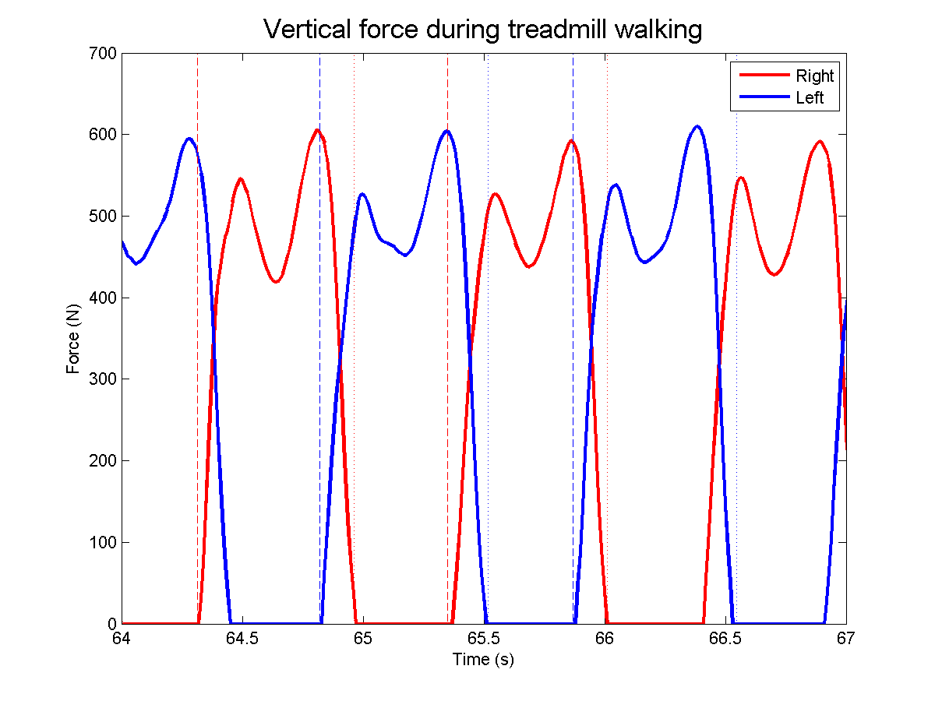
Exercise 3: Automatic initial contact and toe-off detection
Practical session II: ExerciseICTOGRF

Slide 21
Exercise 3: Automatic initial contact and toe-off detection
‘diff’ function
Y = diff(X) returns a vector of length m-1, if X is a vector of length m. The elements of Y are the differences between adjacent elements of X.
Y = [X(2)-X(1) X(3)-X(2) ... X(m)-X(m-1)]

Slide 22
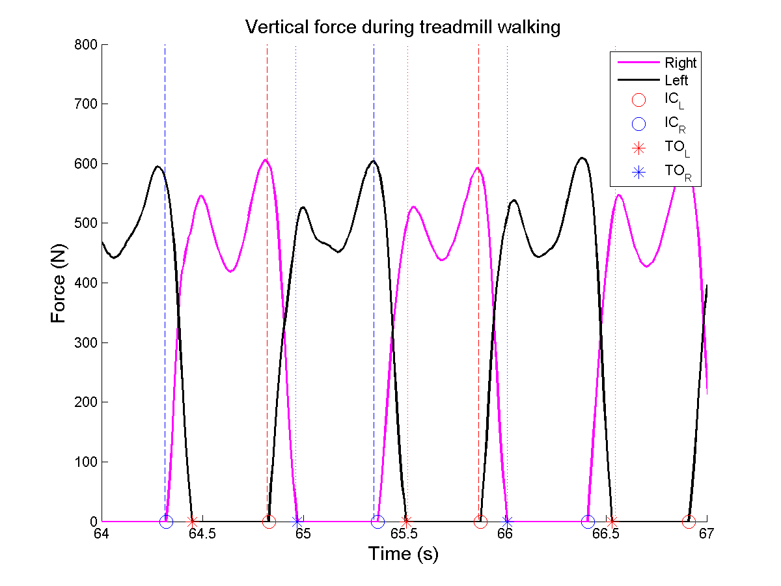
Exercise 3: Automatic initial contact and toe-off detection

